Slide 1
Coronavirus National Testing Programme
Information for employers and personal care assistants on testing for frontline workers
21 April 2020

Slide 2
Testing of children under 18 years of age
If a frontline worker is self-isolating due to an under-18 year old in their household showing symptoms of the coronavirus, that child can be tested.
Testing for children is available at specific sites – see slide 9 for details
Right now tests for 12-18 year olds can be self-administered or the parent/guardian can perform them.
Tests for 5-12 year olds must be administered by the parent or guardian.
Tests are unsuitable for under fives. If the key worker’s child under-five has coronavirus symptoms, please instruct them to follow current NHS guidance https://www.nhs.uk/conditions/coronavirus-covid-19/
This helpful animation demonstrates the drive-through test experience

Slide 3
Introduction
The National Testing Programme provides coronavirus tests to frontline workers or symptomatic members of their household. This is to support the return to work of frontline workers and help employers maximise their workforce capacity during this unprecedented time. When a member of staff reports the need for a coronavirus test, please complete the following actions:
Confirm that the employee is either self-isolating because they have coronavirus symptoms or a member(s) of their household are showing symptoms and are therefore eligible for testing. Symptoms can be found at https://www.nhs.uk/conditions/coronavirus-covid-19/
Send the employee requesting a test the accompanying communication, and insert the sector-specific link your employee must follow to complete their registration for testing. For Personal Care Assistants (PAs), the sector specific link that should be used is ‘Other Government Departments’ (further information is available on slide 10).
You may include your organisation’s logo on the accompanying template in the top middle of the header if you wish, however the HMG logo must remain in the top left with the NHS logo top right

Slide 4
Who is eligible for testing?
☑
☒
Self-isolating because the frontline worker is symptomatic
In this instance the frontline worker is the only eligible person in their household to receive a coronavirus test. No other members of their household are eligible.
Self-isolating because someone in their household is symptomatic, but the frontline worker is not
In this instance only the household member(s) of the critical key worker, is eligible to receive a coronavirus test with the frontline worker’s name noted. The frontline worker will not receive a test as they are not symptomatic.
All symptomatic frontline workers should be tested
Self-isolating for other reasons
If the frontline worker is self-isolating for other reasons and does not have coronavirus symptoms, they are not eligible to be tested
Please note that guidelines for testing specify that individuals are tested within the first three days of showing symptoms. It is therefore vital that eligible employees or members of their household undertake testing as soon as possible.
At present this expanded testing offer covers England and Northern Ireland only. Other Devolved Administrations operate their own registration process
☑

Slide 5
Frequently Asked Questions (FAQs)
Can my family get tested?
If the frontline worker has symptoms, we will only test them.
But if it’s a member or multiple members of your household, they will all get tested up to a maximum of four.
What about others who provide care and support voluntarily? Are they eligible for testing?
Yes. All voluntary workers are included under the NHS/social care definition on gov.uk.
Can you walk in or taxi to a test site?
You must drive/be driven to the test site in your own household’s car. There is no option for public transport, walking or taxis.
When will I get the results?
As quickly as possible. We expect this will take up to 48 hours from the point of testing.
Does the test hurt?
The test involves taking a swab of the nose and throat. You may experience some mild discomfort and you may feel a gagging sensation, but it should not hurt.
When is the right time to get tested?
The test is designed for anyone showing coronavirus symptoms and is most accurate if it’s taken in the first three days of showing symptoms.
What will the test tell me?
The test will confirm if an individual who is showing symptoms of the disease actually has it.
It will not confirm if you have had it and have now recovered.
How will I get my results?
You will get your results by email or text. We are aiming to return results within 48 hours of taking the test.

Slide 6
Additional FAQs for PAs
Which of the sector-specific online links are for PAs?
You should register under ‘Other Government Departments’. This is because Government has deemed PAs to be a key, frontline worker- and as such has referred this group as eligible
What ID do I take?
If you do not have an employer ID, please take your confirmation email received through registration, along with the filled-out temporary PA ID as attached within page 4 of your invitation to testing letter
Can my employer get a copy of my test results?
As a PA, it is your responsibility to communicate your own, or your household member’s, test result to your employer and together discuss a return to work.
What do I do if the test centre turns me away?
As a PA, you should not be turned away, and test centres have been directed that you are a key frontline worker, and have access accordingly. If you are refused entry, the security guard should immediately contact your employer, who can provide confirmation of employment.
Will I be paid transport costs to access this test?
There are no central plans to fund transport costs. If you believe this is required, you should discuss this with the CCG/LA who provided the direct payment.
Further FAQs can be found at https://www.skillsforcare.org.uk/COVID-19IEPA.
This FAQ will shortly be updated to include additional questions on testing.

Slide 7
Test registration Process – Employer action
Communicate to frontline workers who have reported that they are self-isolating due to having coronavirus symptoms or because a member of their household has symptoms that tests are available
Ensure the frontline worker understands that they can only attend a test site if they have a car or that a member of their household has a car. They must drive/be driven to the test site. A smartphone capable of scanning a barcode is also required
Send the frontline worker the attached communication.
The frontline worker must present their employer-issued ID on arrival at the test site. Where they do not have an ID, they will be asked to present the confirmation email. PAs should also take their filled out, temporary PA ID with them, as provided in the annex to the registration letter

Slide 8
Sector-specific online registration links
OFSTED – includes Children’s social care workers and services
Police Forces – includes British Transport Police
Other Government Departments (OGDs) - includes Ministry of Justice, HMPPS, HMCTS, Ministry of Defence, Home Office, Dept. for Transport and all other relevant departments. This is the link that employers should provide to their PAs, and that PAs should use to register for a test- this link has been embedded in slide 5, and the invitation letter.
Pharmacy - includes Community Pharmacy
Private Sector – includes Energy and Utilities, Food Production, Movement of Goods, Workers involved in the continuity of essential travel, Providers of ancillary support to NHS workers
Local Resilience Forums* - includes Fire and Rescue Service, Maritime and Coastguard Agency, Local Authority staff
*Local Resilience Forums are asked to forward this information pack and accompanying invitation to their forum members, so that they can send invitations to their eligible employees who are self-isolating and have requested a test from their employer

Slide 9
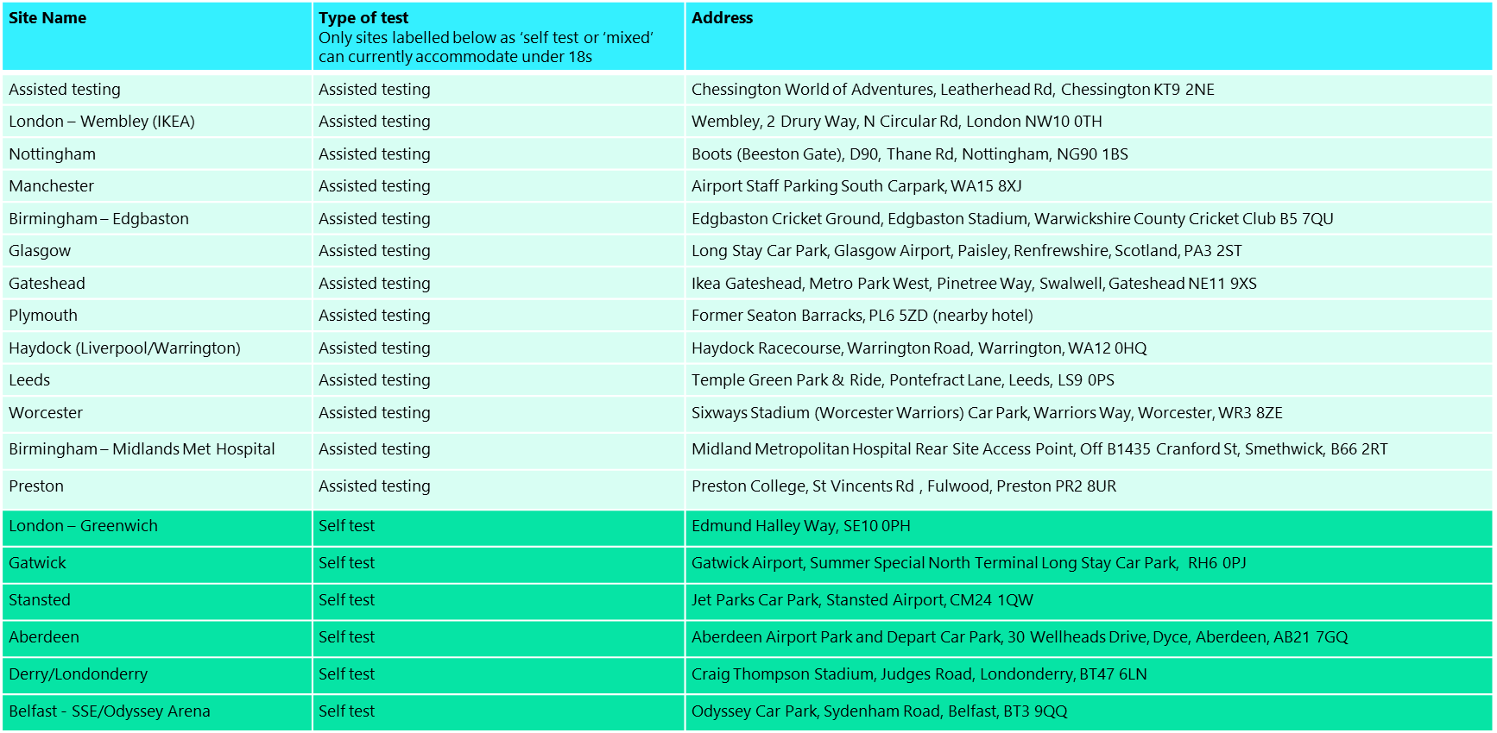
Regional Test Site Locations
Notes:
*Expanded test offer currently covers England only

Slide 10
Online registration disclaimer
The online registration form is being provided by the Care Quality Commission (CQC).
This is a temporary facility being provided in-kind by CQC colleagues as an interim solution whilst the permanent digital portal is being developed by the NHS.
DHSC retains full accountability for the provision of this temporary online registration solution.

